Slide 1
Design documentation

Slide 2
today
Investigate documentation needed to demonstrate a solution to a given problem

Slide 3
Last time
Last lesson, we looked at:
Abstraction of data
Use of predefined code
Readability of code
Quality of code
Why are these topics important when creating a piece of software?

Slide 4
Last time
Last lesson, we looked at:
Abstraction of data
Use of predefined code
Readability of code
Quality of code
Why are these topics important when creating a piece of software?
Create programs that not only perform well, but are also easy to read and highly efficient.

Slide 5
Example problem
To add to our understanding of the following diagrams and charts…
…we will use an example problem:
A user is to enter 3 integers
Two messages are to be displayed:
The mean average of the numbers
The largest integer

Slide 6
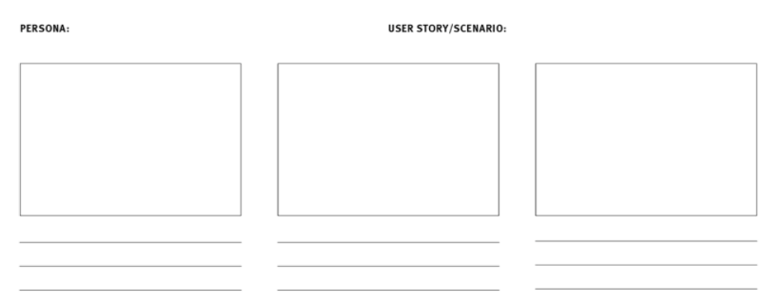
Storyboards – an overview
Communicate the story through images
Scenario
Visuals
Captions
Persona -> user story

Slide 7
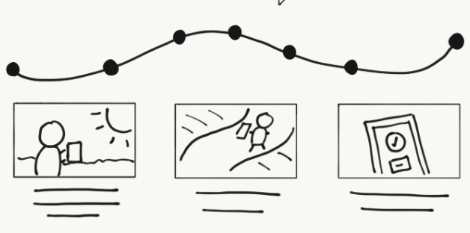
Storyboards
An example:
James, a mechanic
Wants to enter MOT details
Into the database
Then order parts needed to fix car

Slide 8


Slide 9
Our Storyboard?
Try it now – use word!
Or any online storyboard maker
A user is to enter 3 integers
Two messages are to be displayed:
The mean average of the numbers
The largest integer

Slide 10
Input-process-output chart (ipo chart)
The IPO chart shows:
What data items are input
What processing takes place on the data
What information will be the end result – the output.
High level, structured thinking about the problem

Slide 11
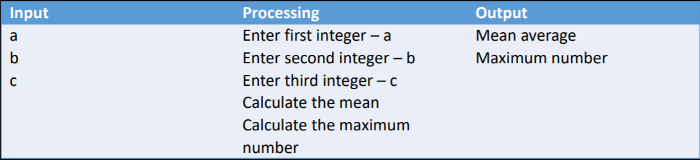
The output is first completed
The input is second
Processing last
Sounds odd, but think about planning a holiday:
First you decide where you want to go (output)
Second you plan the method of how to travel, what to take, etc. (input).
Lastly plan the route and logistics (processing)

Slide 12
Data dictionary
Data dictionaries are used a lot with database solutions, but…
…they are equally as useful for any programming solution.
Let’s look at an example…

Slide 13
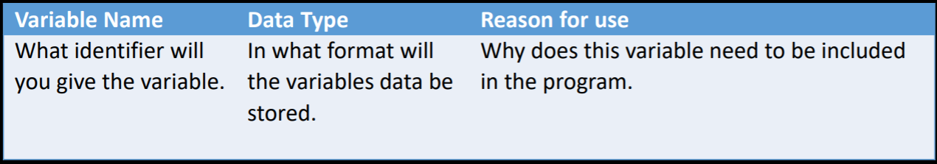
Data dictionary

Slide 14
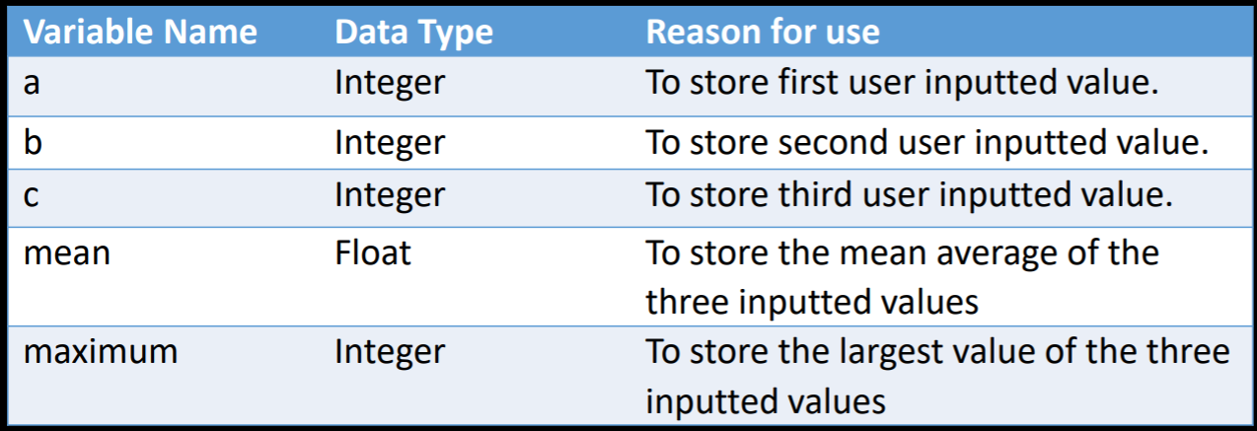
Data Dictionary (example)

Slide 15
Writing Algorithms
Once the previous charts have been created, the next step is to develop sets of instructions for a computer to follow.
These are the algorithms.
To complete all of the algorithms, instructions for each module in the solutions structure diagram must be written.
Setting up the algorithms is probably the hardest part of problem solving using a computer.

Slide 16
Algorithm Design
When designing algorithms, follow:
The instructions must be precise, they cannot assume anything
You must not leave out or skip steps
Must be executable, one step at a time
Must be complete
Remember that a computer can only do what it is told, it cannot guess what should be done.

Slide 17
Algorithm Representation
There are two ways to represent algorithms:
Flowchart – graphical
Pseudocode – textual
We have covered these in detail in previous lectures.
Next lecture we will look at software testing

